Slide 1
Fruit Batteries
& Electricity
Electrifying the Future 2024

Slide 2
What is electricity?

Slide 3
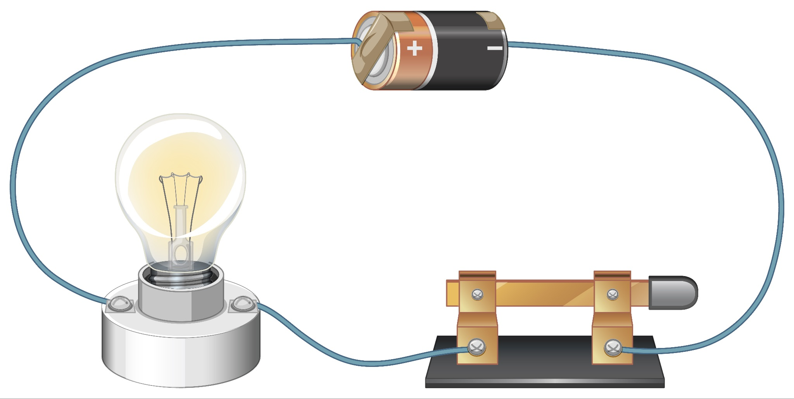
Electricity is a type of energy that can be produced in different ways and powers things like lights and heaters.
It is the movement of tiny particles called electrons. which we call an electric current.
There's a rule in electricity that says current equals voltage.
A circuit is a connection of different parts that lets electricity flow through.
Some materials, called conductors, allow electricity to pass through them easily.
A conductor is typically a metal, like copper.

Slide 4
What are some examples of electricity in everyday life?

Slide 5
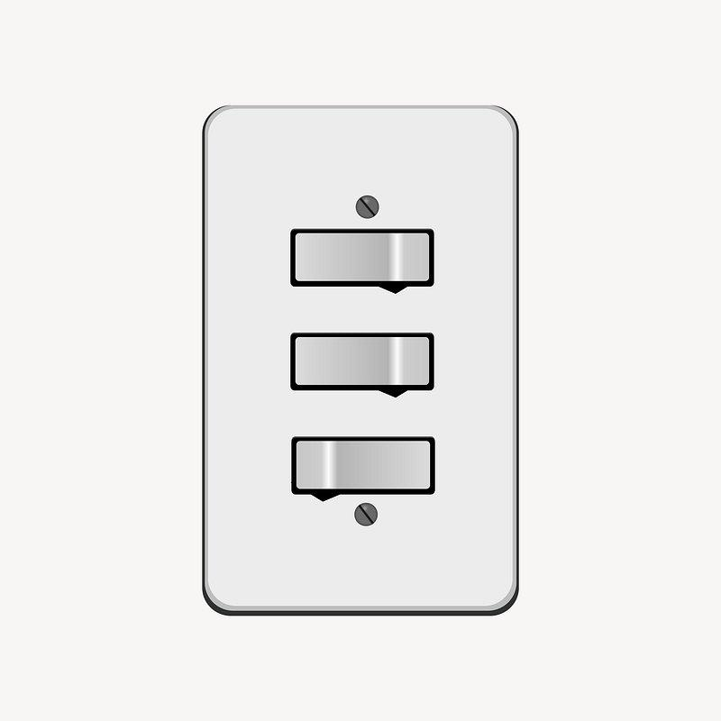
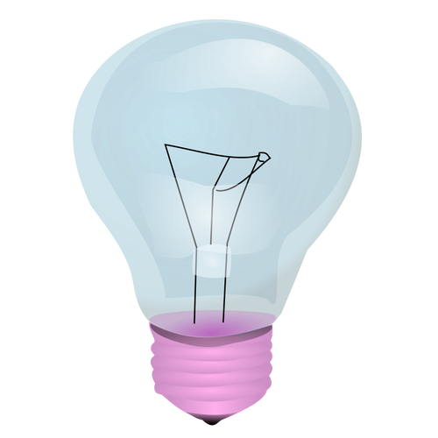
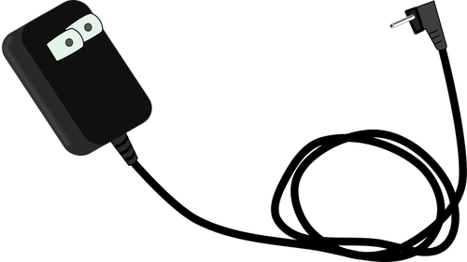
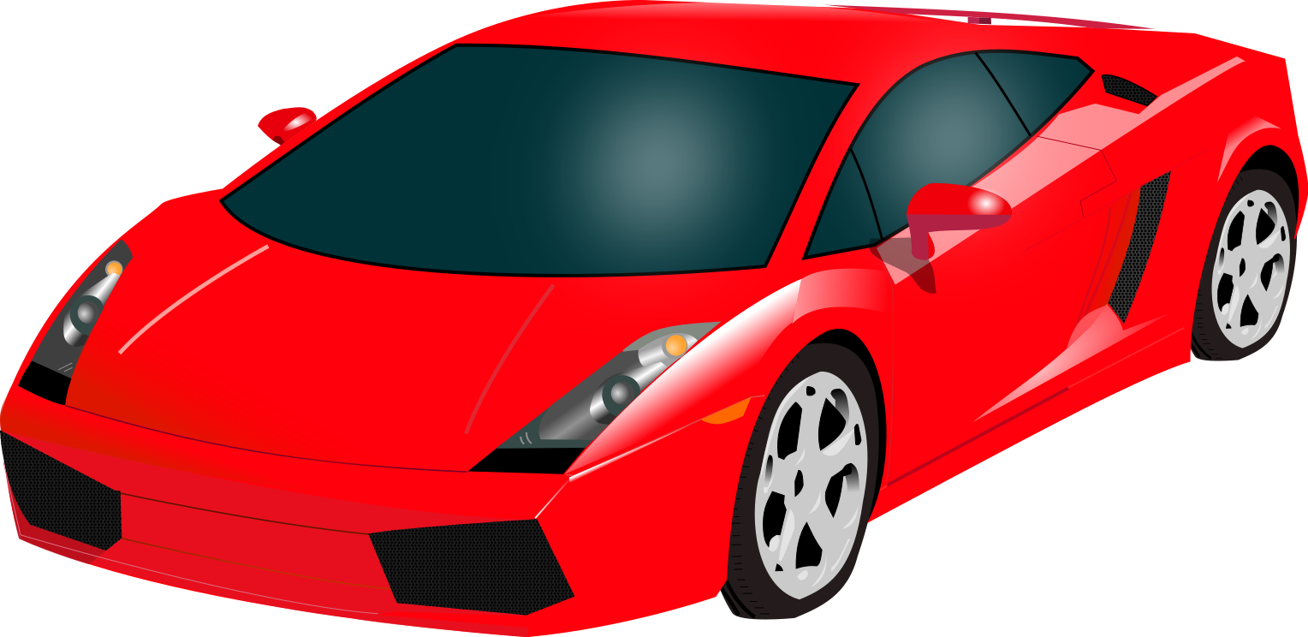
Everyday Electricity
Light Switches
Light Bulbs
A switch is used to control the flow of electricity from the power source to lights or wall outlets.
The filament - a thin wire in the light bulb that carries electricity.
Chargers
Electric Cars
An adapter changes the kind of electricity from our wall socket (alternating current) into another kind (direct current) that some devices need to work. - ex. An ipad needs this to work
Electric cars are powered by storing energy from the electrical grid in batteries

Slide 6
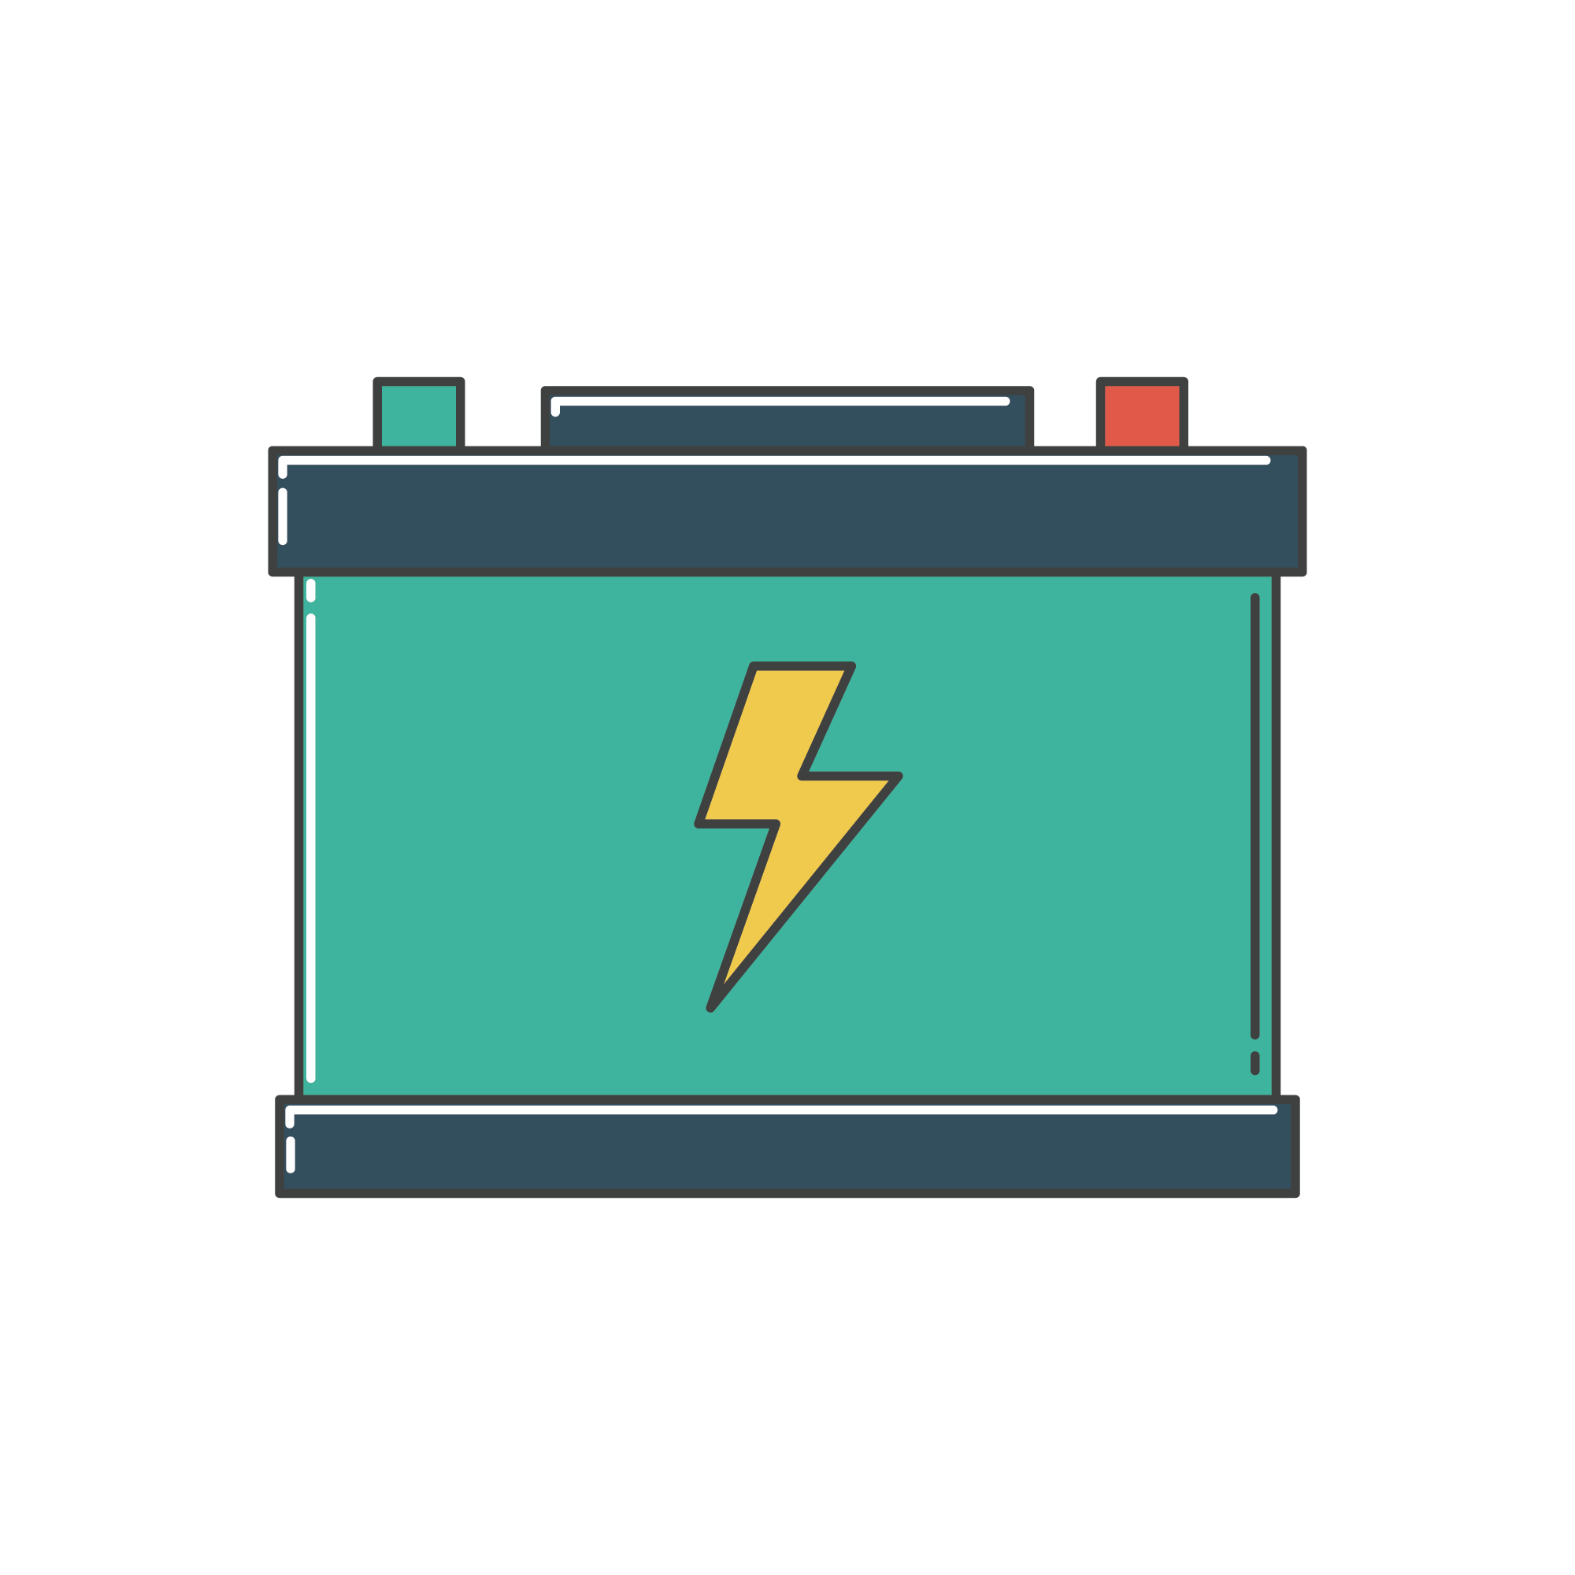
What is a Battery?
A battery is a device that can create or store electricity with the reaction of certain chemicals.

Slide 7
Electric Cars and Batteries
Electric Cars receive energy from charging stations and store the electricity
its Battery!

Slide 8
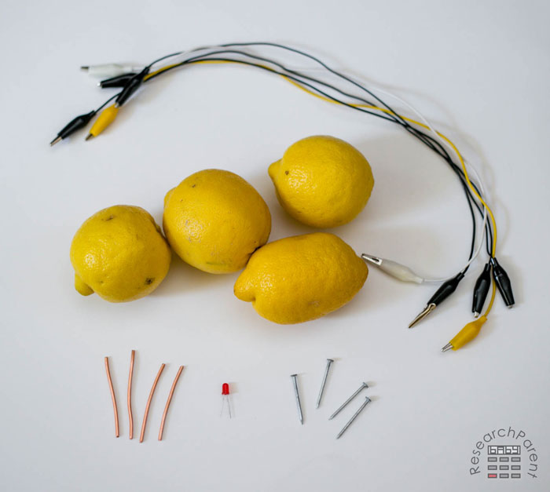
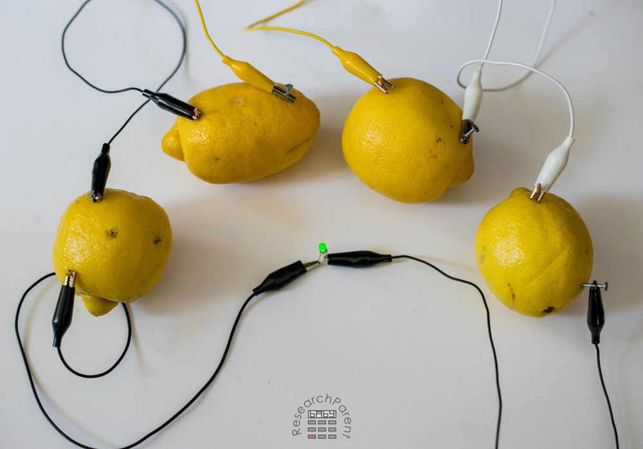
Time to make electricity!
Notes:
What are they?
Answer: Copper and Nickel
This focuses on two of some of the most mined minerals in sudbury that have great value. We do mine other minerals, however we are focussing on Copper and Nickel.

